Slide 1
How Bitcoin Works: A Transaction Journey

Slide 2
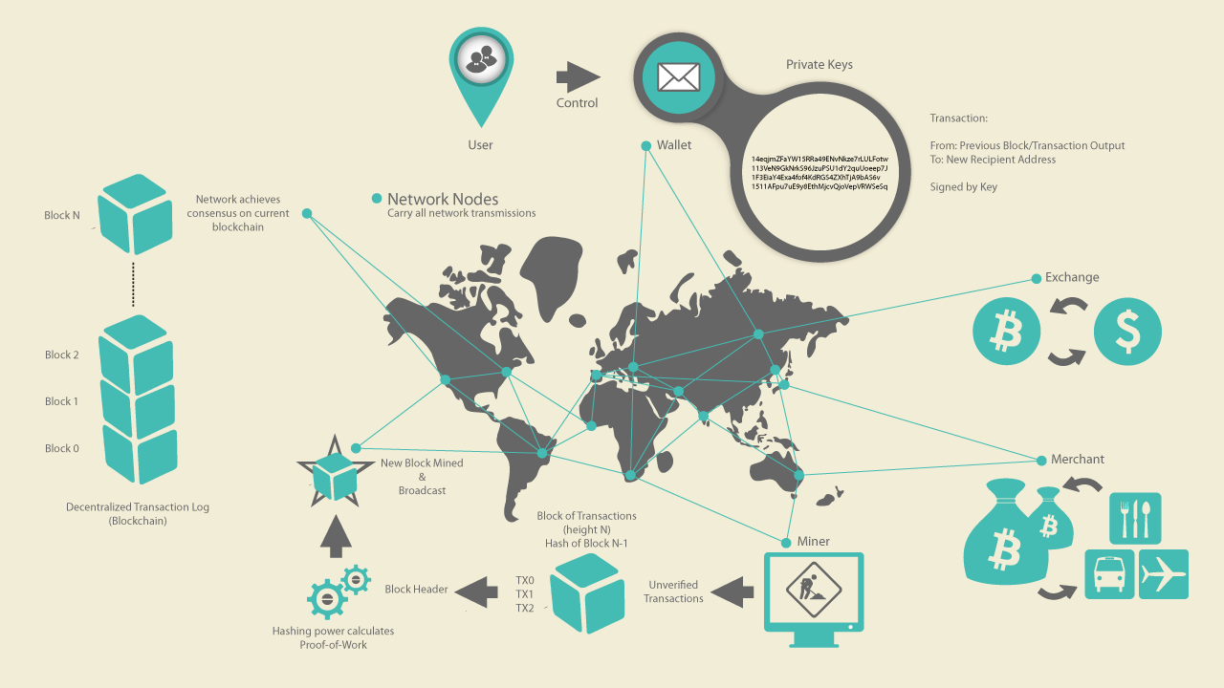
Network Structure

Slide 3
Buying A Cup of Coffee
The user gets the option for paying in dollars or satoshes
Total:
$1.50 USD
0.015 BTC

Slide 4
A Transaction
A transaction tells the network that the owner of some bitcoin value has authorized the transfer of that value to another owner.
The new owner can now spend the bitcoin by creating another transaction that authorizes the transfer to another owner, and so on, in a chain of ownership.

Slide 5
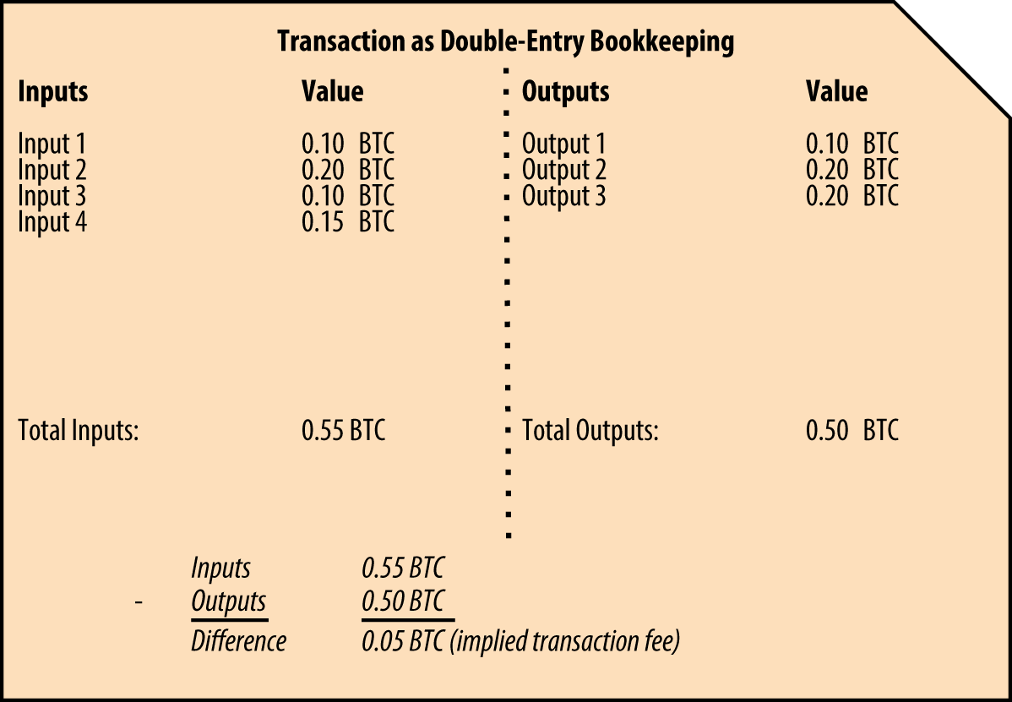
Typical Transaction

Slide 6
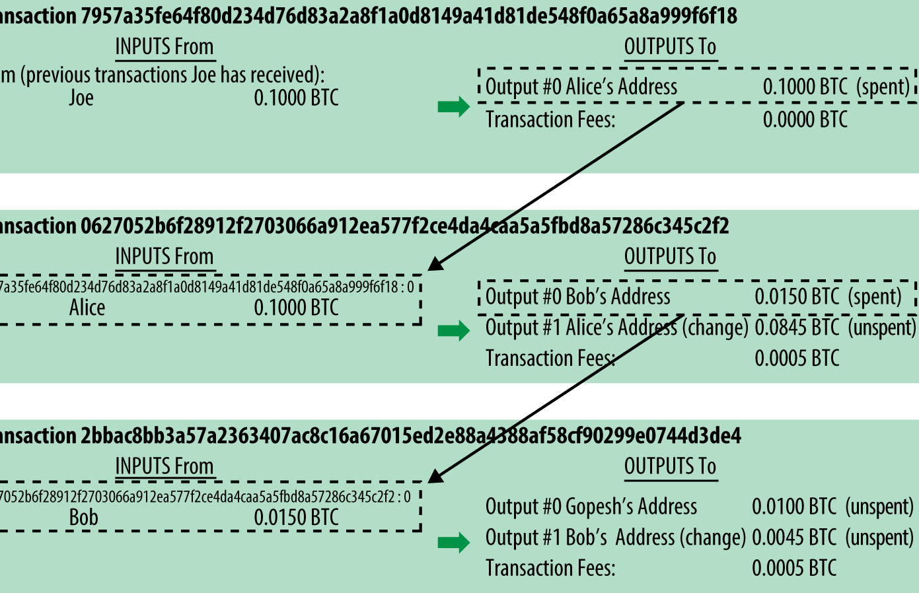
Chains of Transactions

Slide 7
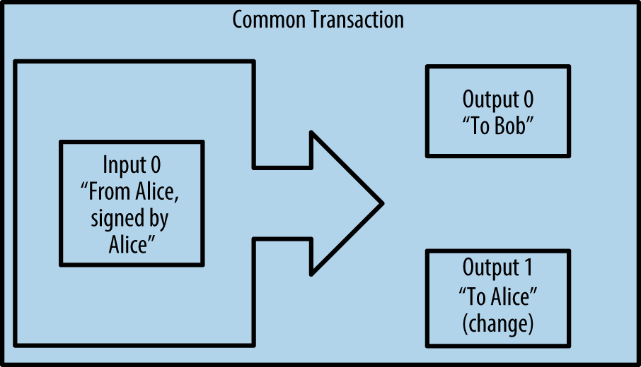
How Payments are Performed

Slide 8
Wallet Application
wallet application contains all the logic for selecting appropriate inputs and outputs to build a transaction to Alice’s specification.
The user only needs to specify a destination and an amount, and the rest happens in the wallet application without her seeing the details.
The wallet application can construct transactions even if it is completely offline.

Slide 9
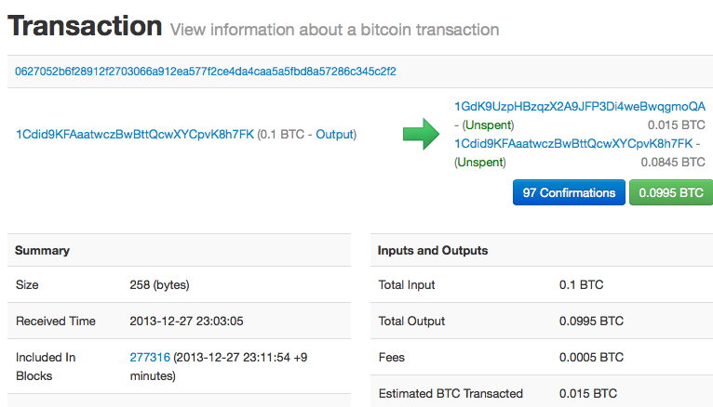
A Real Transaction

Slide 10
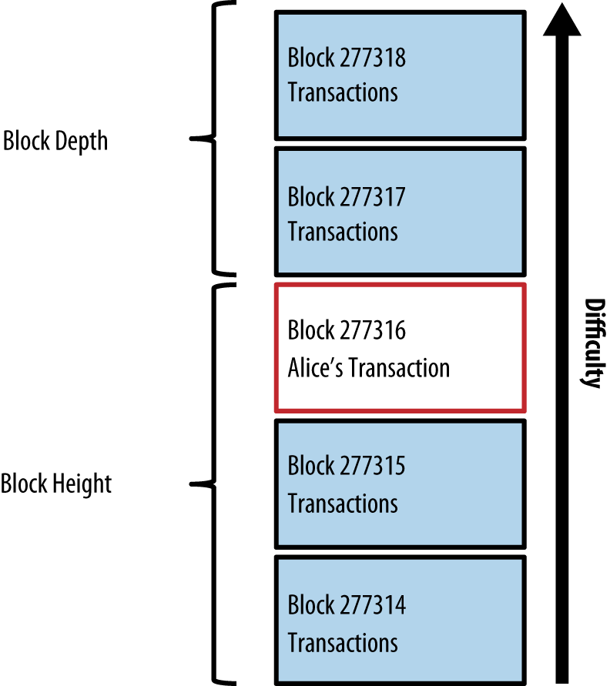
Mining

